Slide 1

AGV
Rob Mop

Slide 2
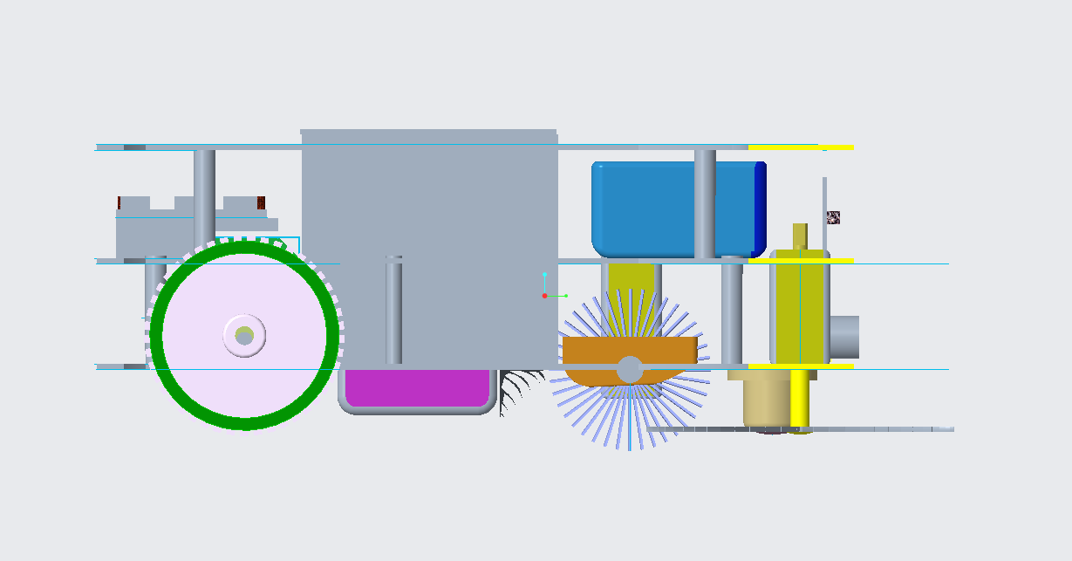
Automatic guided vehicle (AGV)

Slide 3
Components used
Base | Senosrs | Controllers | Others
Acrylic sheets- 3mm | Ultrasonic sensor | Raspberry pi -4 model B | Motor
 | Infrared sensor | Arduino UNO | Wheels-r(3.5cm)
 | IMU(Inertial measurement unit) | Motor controller | Castor wheel
 | Encoder |  | Clamps
 |  |  | Spacers
 |  |  | Breadboard

Slide 4
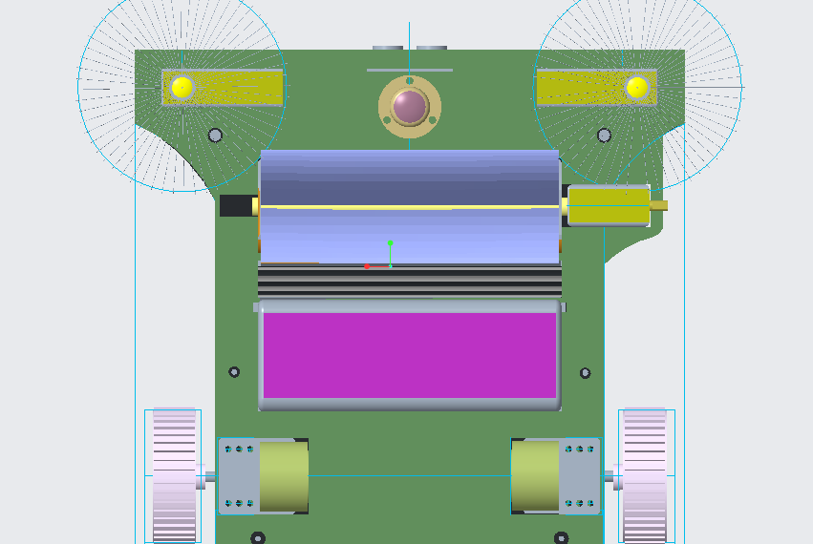
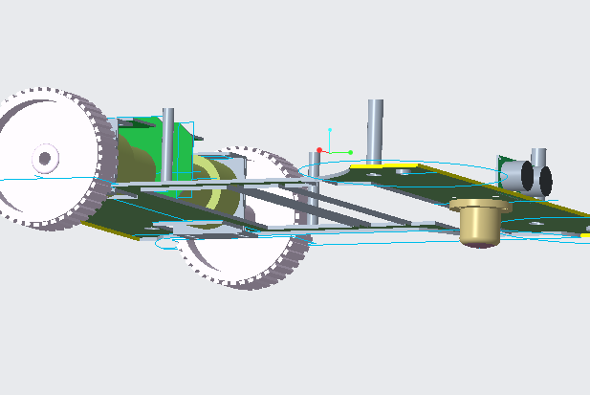
Base

Slide 5
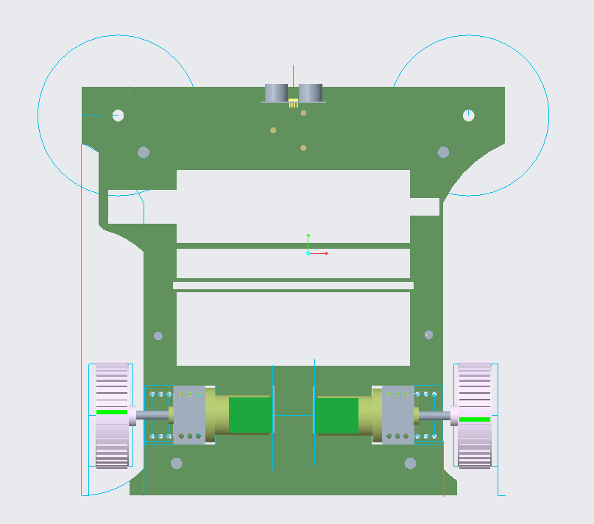

Slide 6
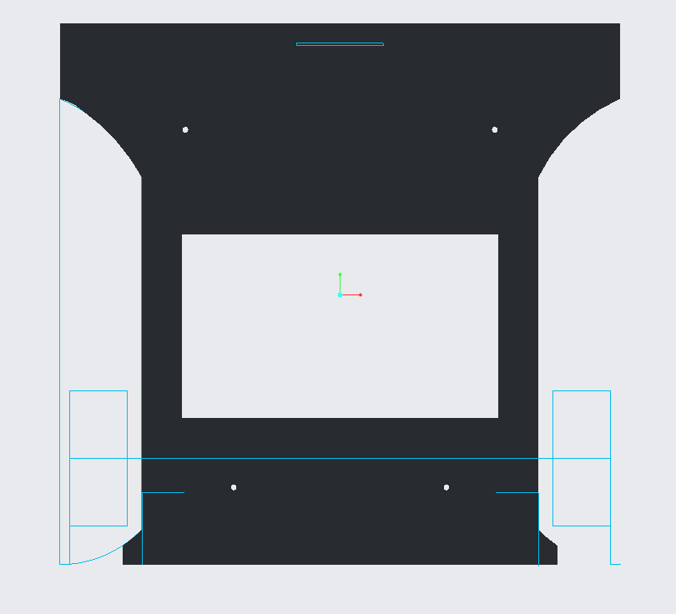
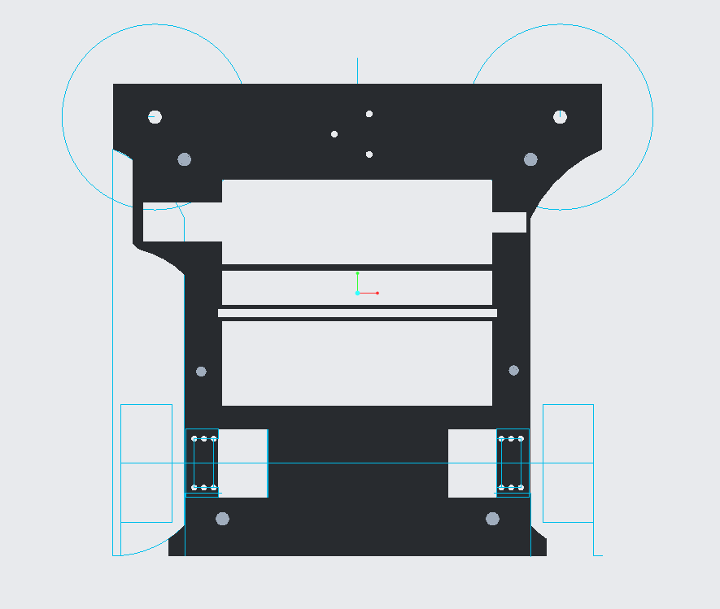
Base part -1

Slide 7
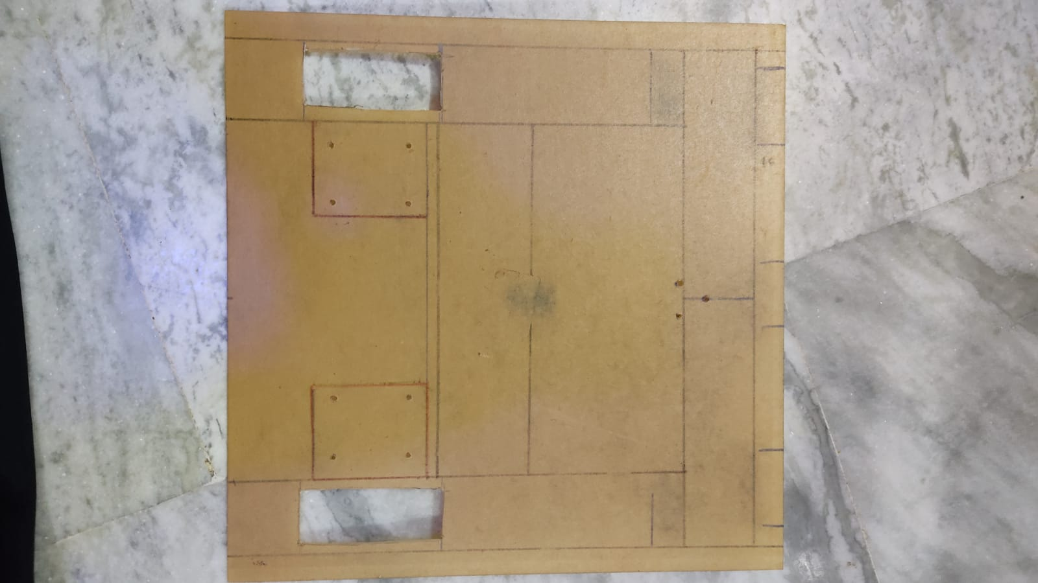
Acrylic sheet –Base part 1

Slide 8

Sensors

Slide 9
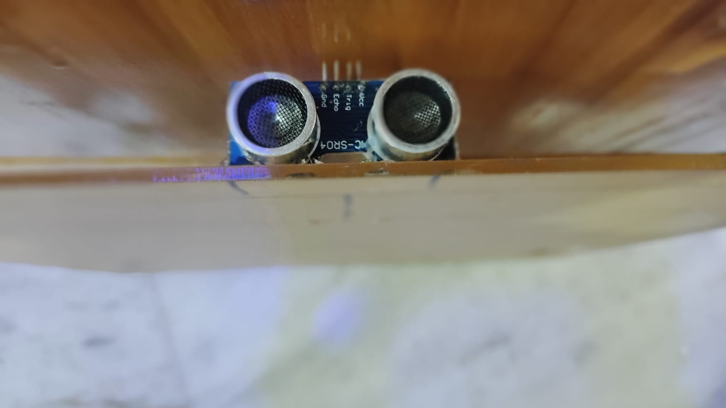
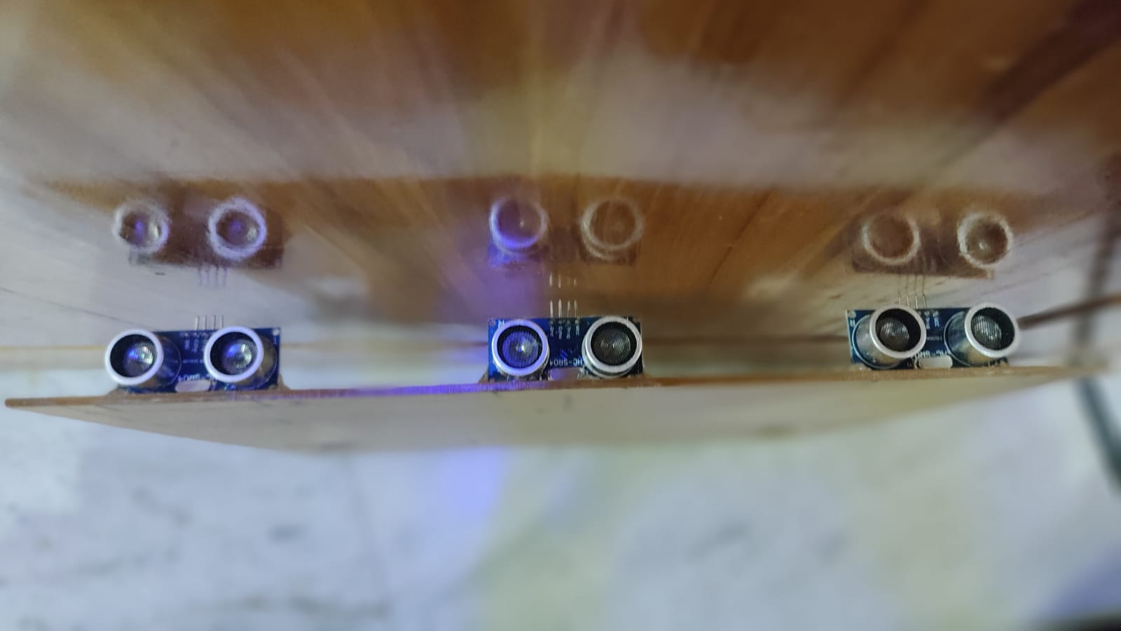
Ultrasonic sensor
Voltage capacity: 5V
Output signal: 5V high and 0V low
Sensor angle not more than 15 degree
Sensor bounce back: 2cm to 450cm

Slide 10
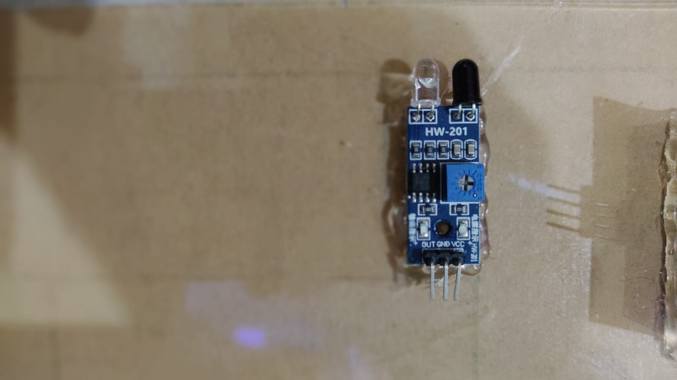
Infrared sensor
Range : 10-15 cm|
Input supply voltage: 5V DC

Slide 11
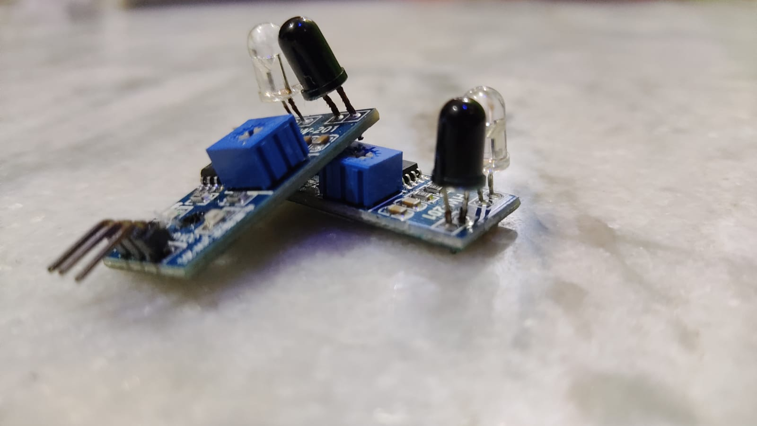
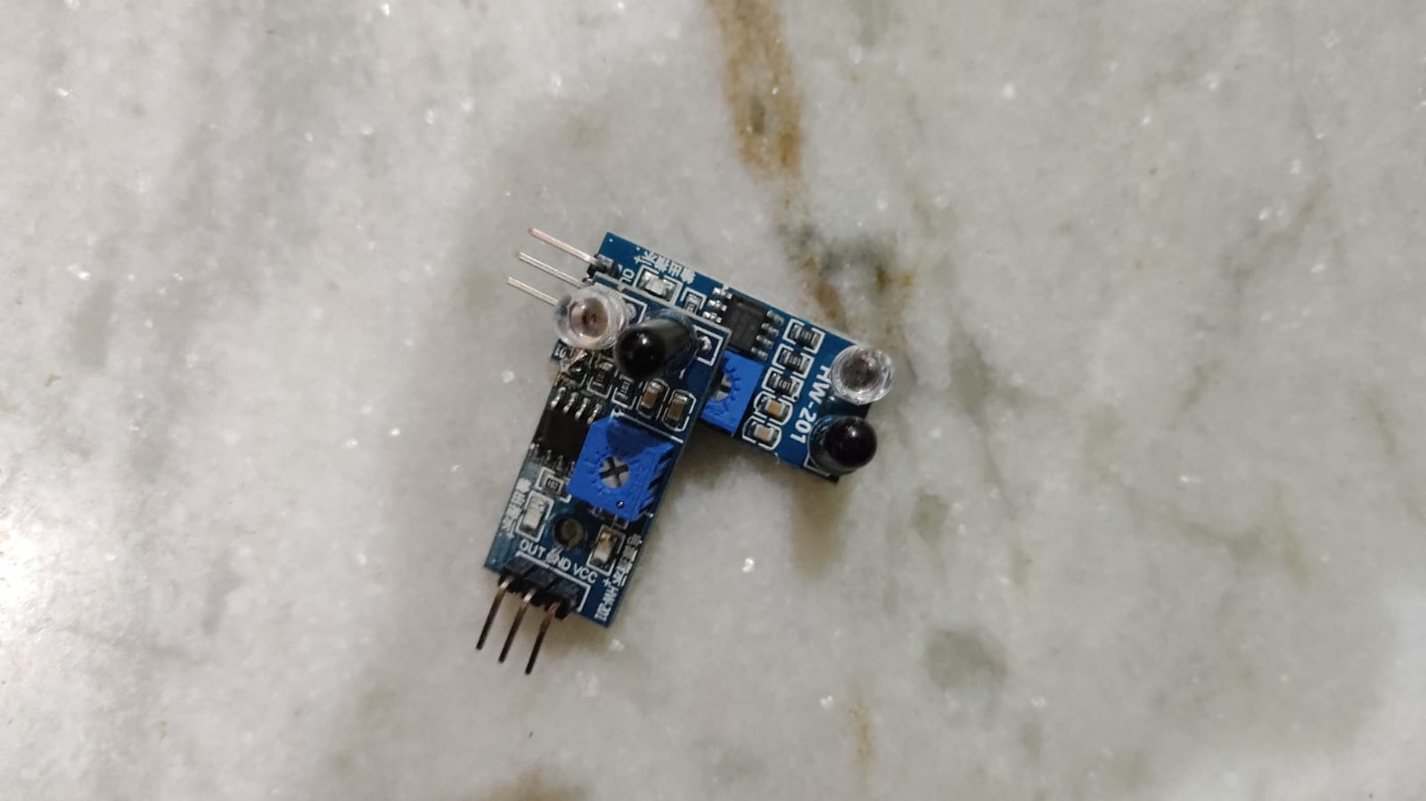

Slide 12
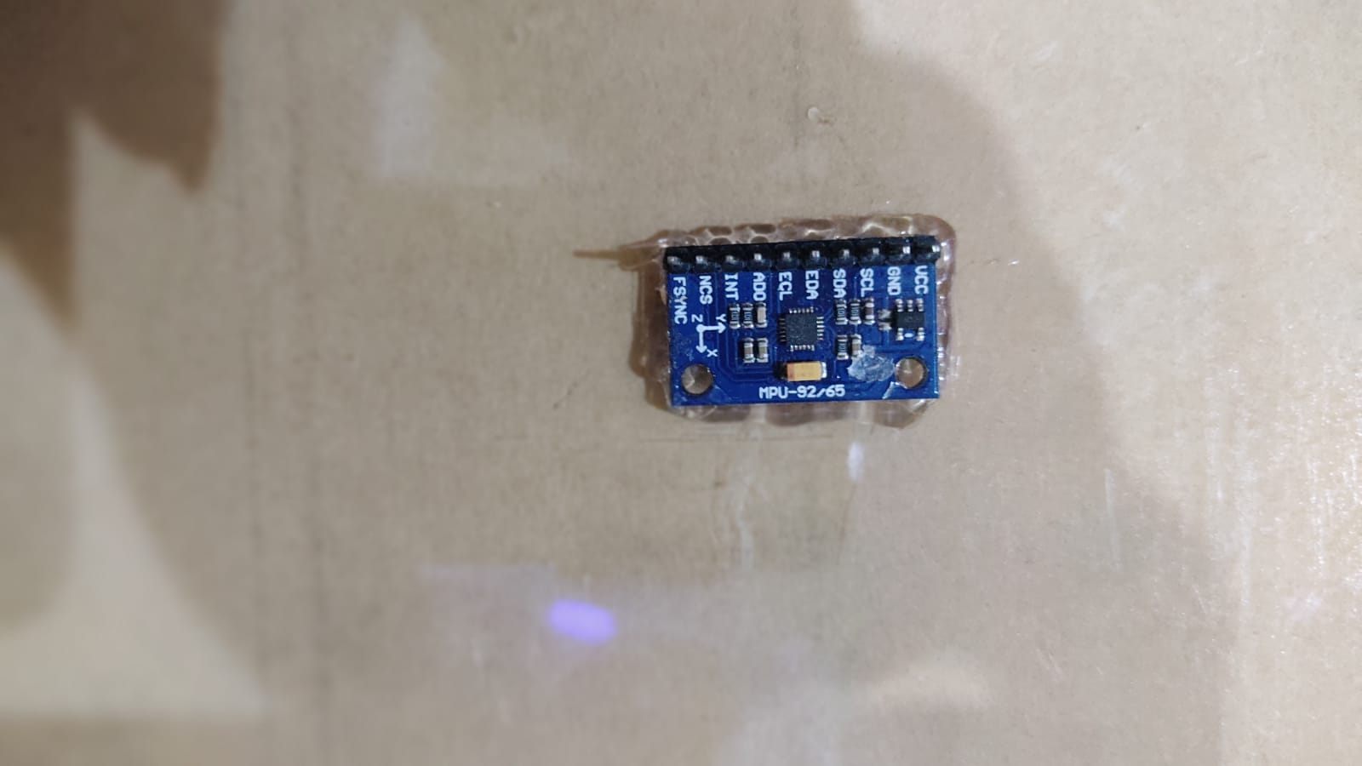
IMU
9 axis IMU measures orientation, velocity, and gravitational forces by combining Accelerometer, Gyroscope, and Magnetometer into one.

Slide 13
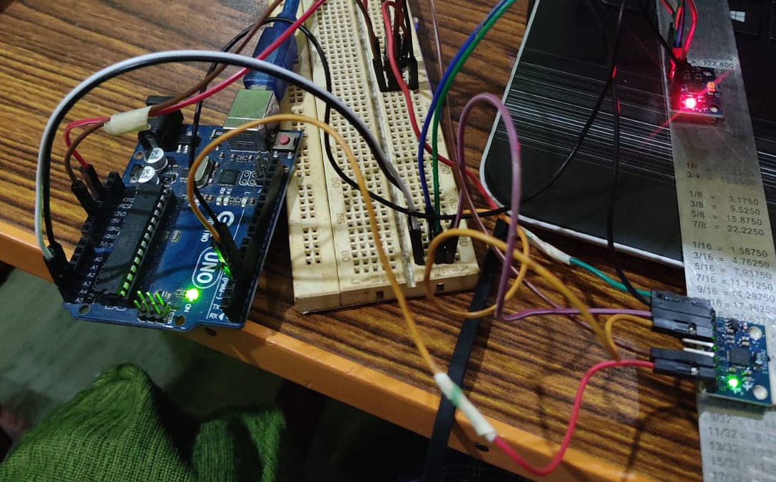

Slide 14
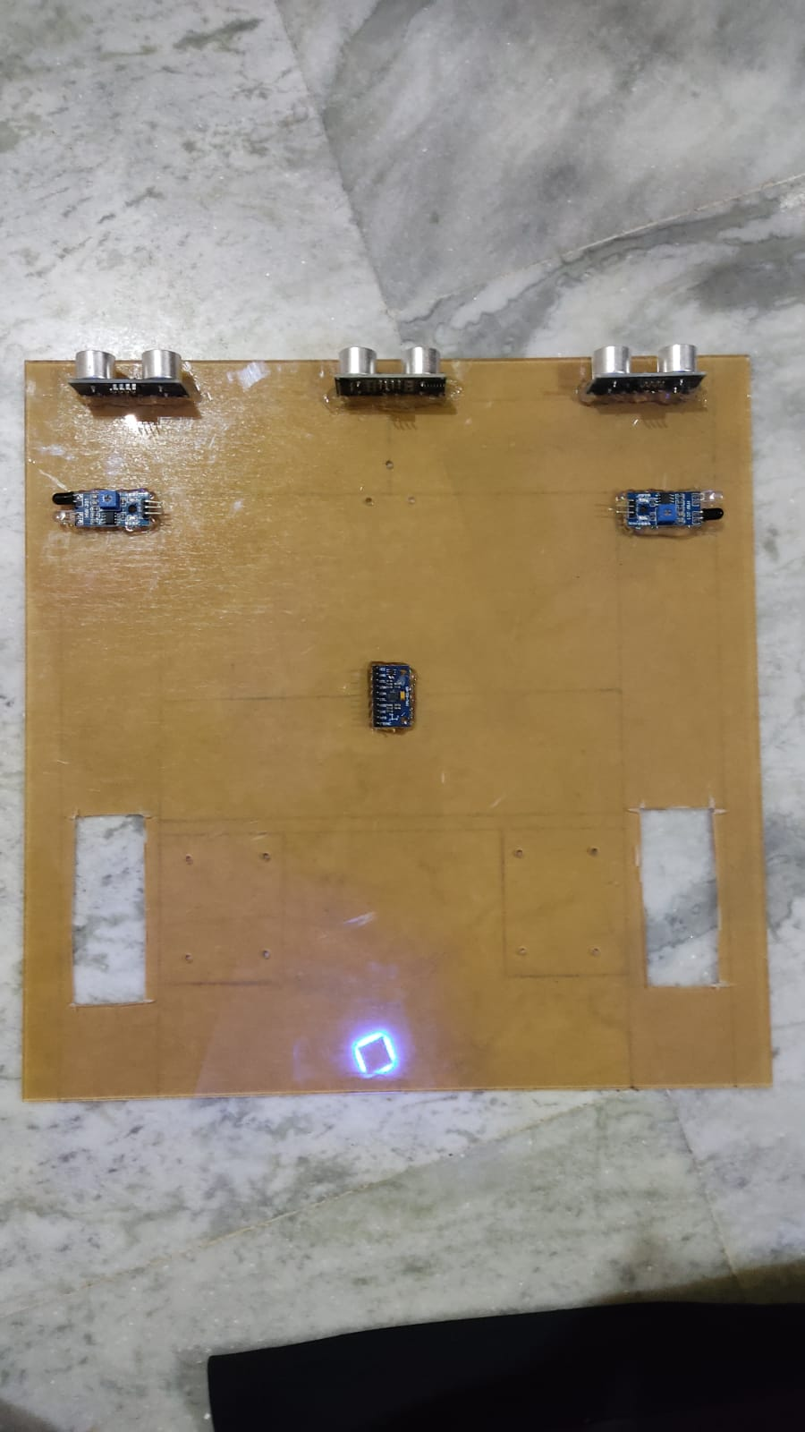
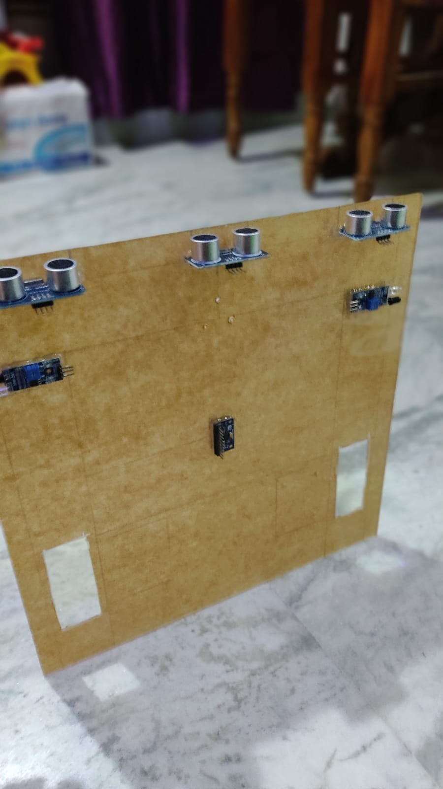

Slide 15

Controllers

Slide 16
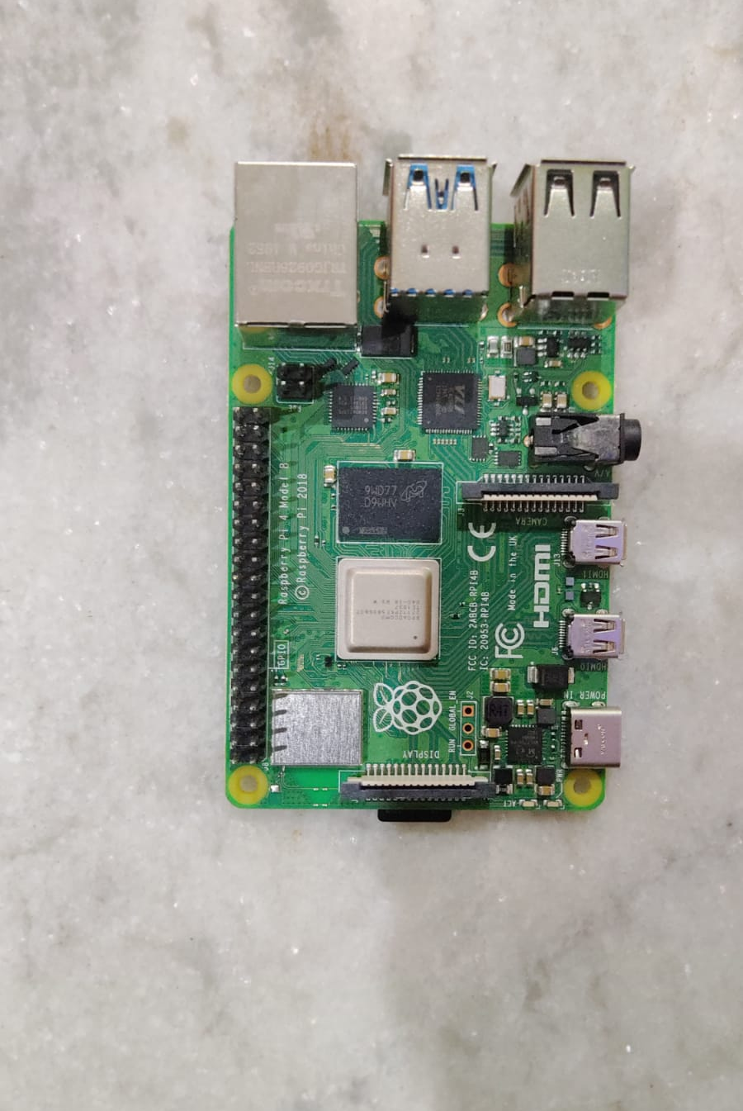
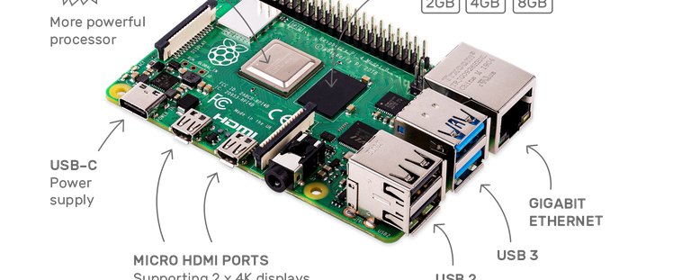
Raspberry pi model 4-B

Slide 17
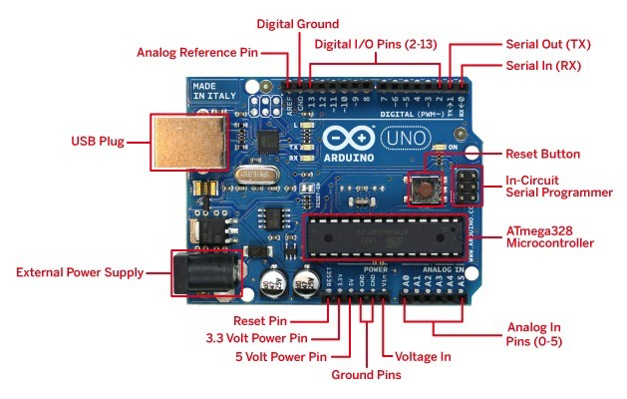

Arduino UNO

Slide 18
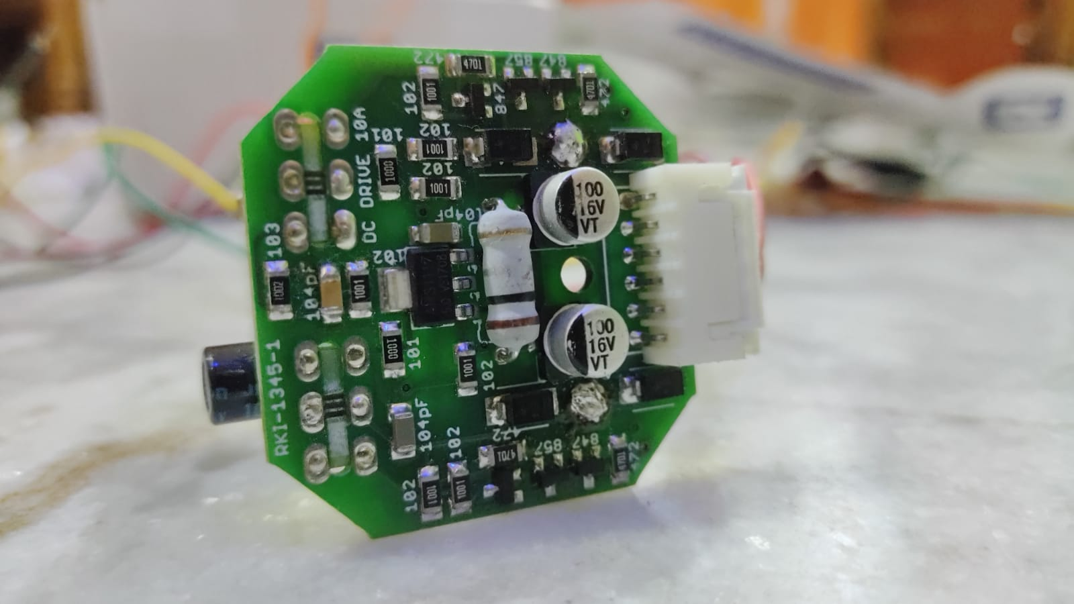
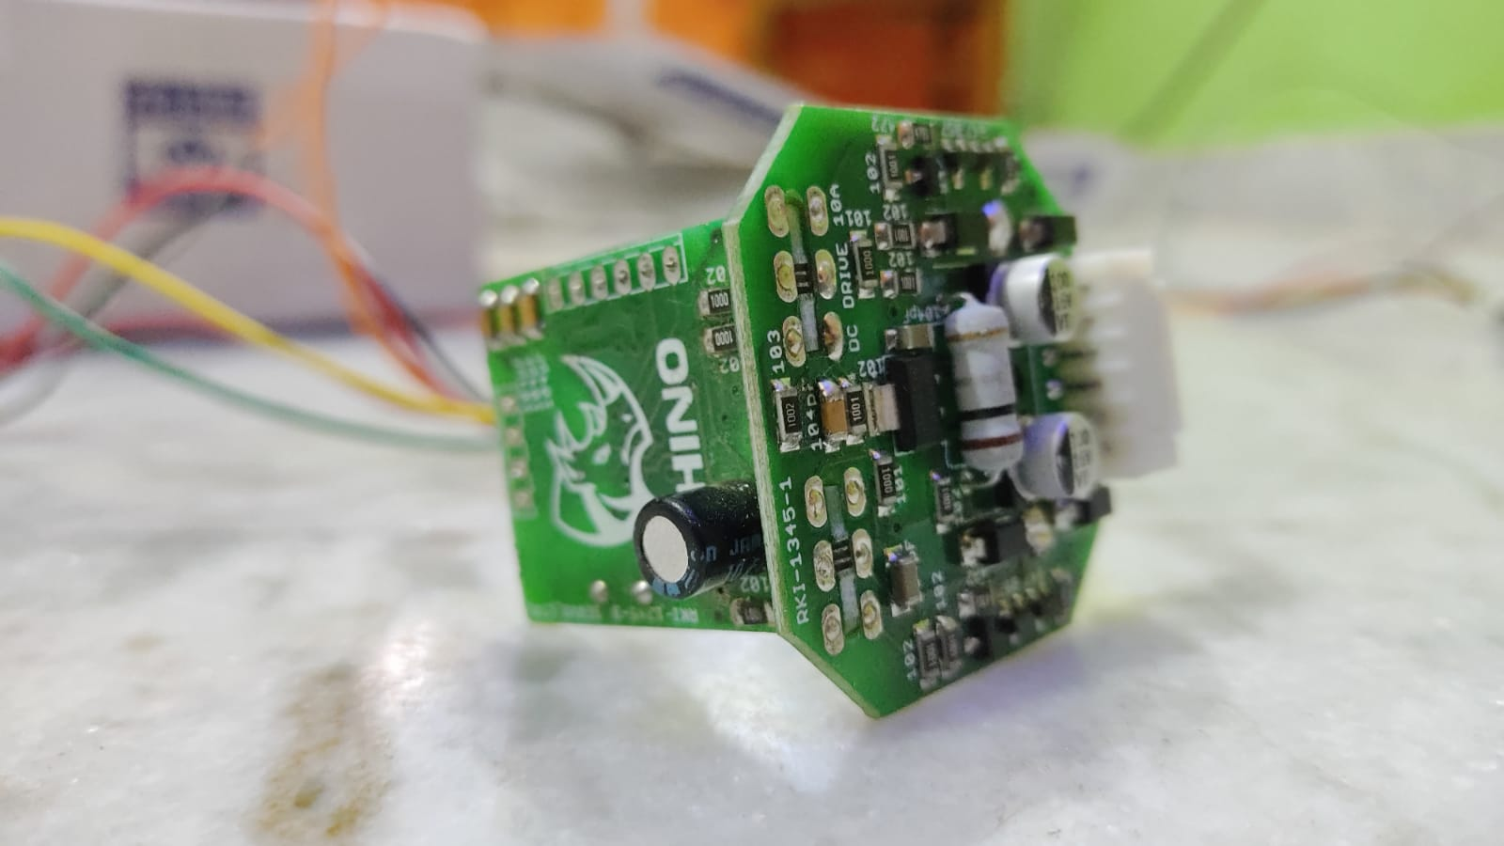
Motor driver
Motor speed control interface via UART, I2C, PPM signal and analog input
Speed control possible in both directions down to almost 1% of max. speed
Speed can be controlled using a terminal or MCU via simple UART commands

Slide 19
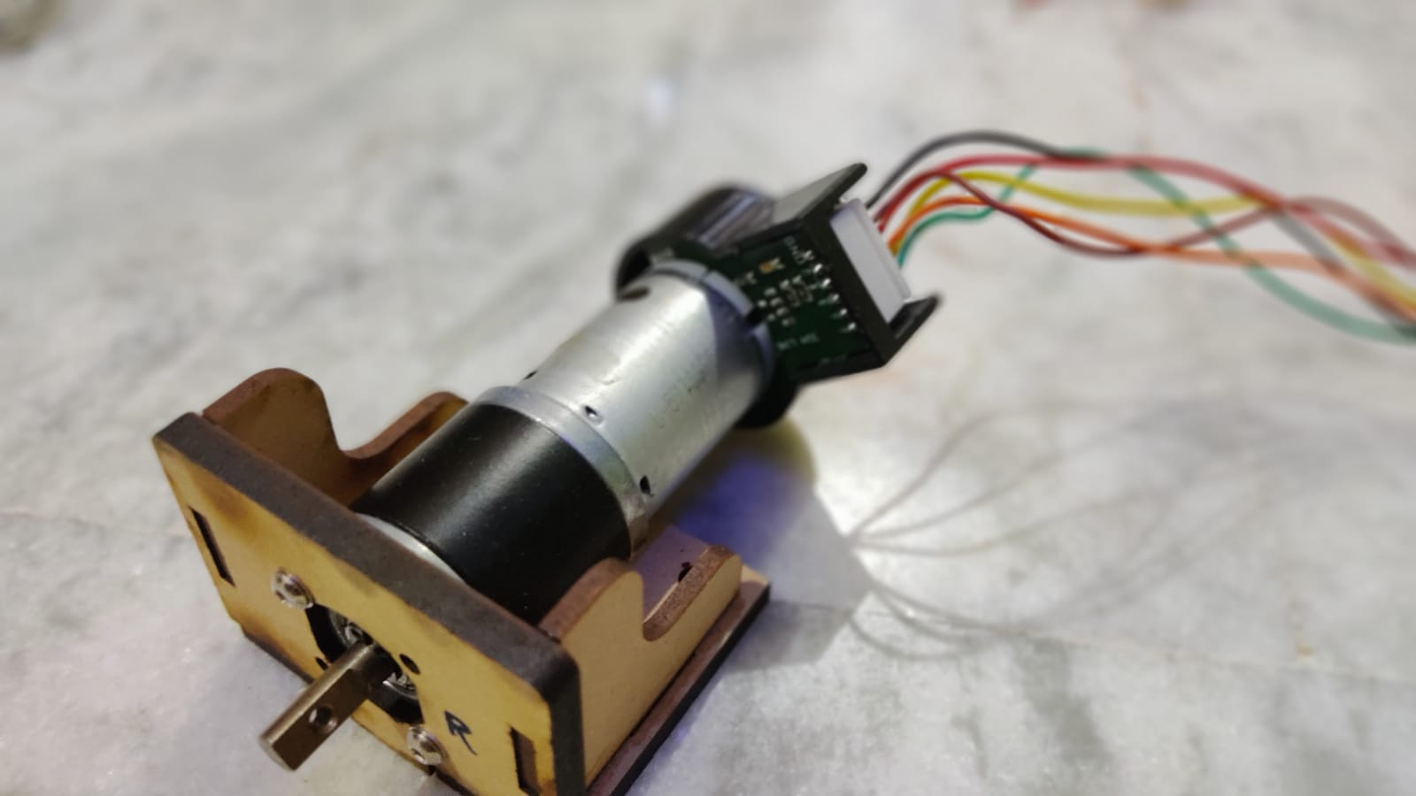
Motor
200 RPM 12V Rhino Planetary High Precision Encoder Geared Motor with Metal Planetary Motor High Precision Encoder and Metal Gears
18000 RPM base motor
3 stage gearbox for optimum high torque operation
Motor rated Torque is 15kgcm along with gearbox and stall torque is 60kgcm, however it is recommended to use the motor at rated torque for optimum life and efficiency.
Shaft is D type with total length of 16 mm and D shape in 12 mm.
6mm Dia shaft with M3 thread hole for tight mounting.
Shaft can be coupled using CNC coupling 6 mm or using fixed coupling as per requirement.
Back shaft length is 9 mm
Gearbox diameter is 32 mm.
Motor Diameter 28.5 mm
Length 81.5 mm without shaft
300gm weight
No-load current : 800 mA, Load current : upto 7.5 A(Max)

Slide 20
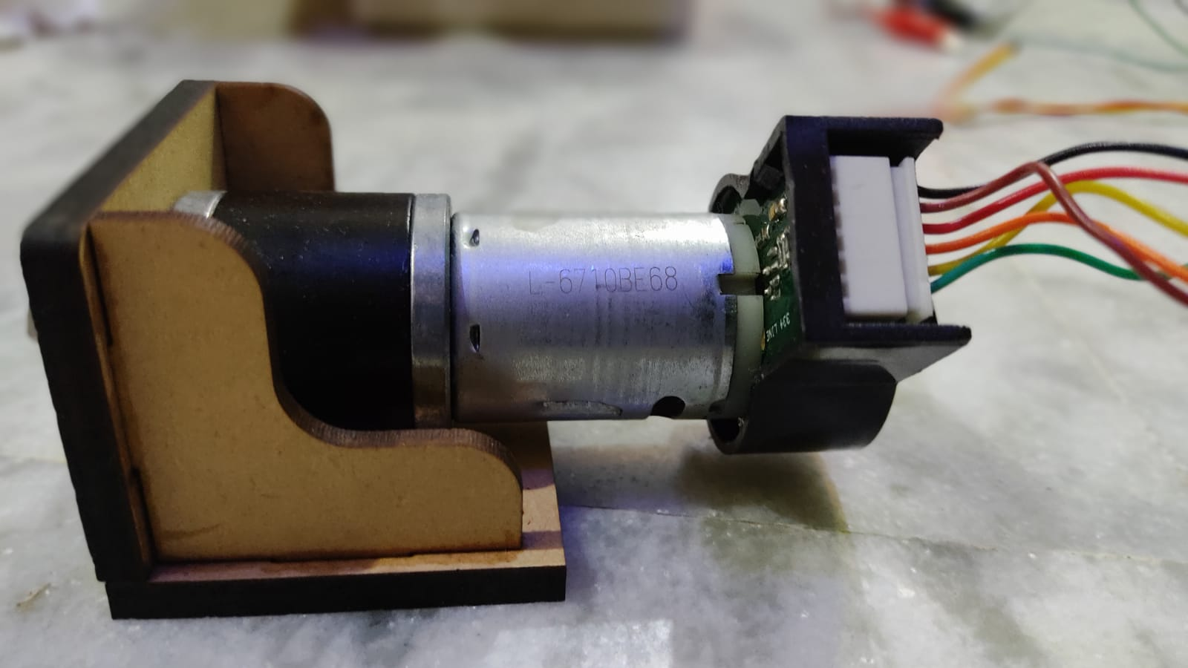
Encoder
Counts per revolution (CPR) :1,33,600
Red: EncB
Orange: EncA
Yellow: Motor-
Green: Motor+
Brown : Vcc +5 V DC
Black : Gnd. *This is to be kept isolated from Motor Ground.

Slide 21
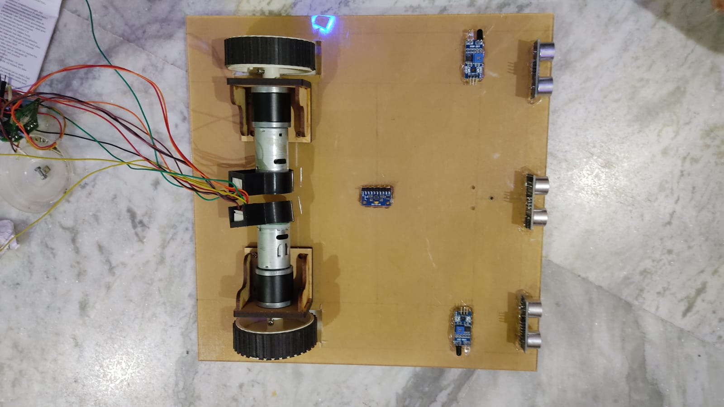
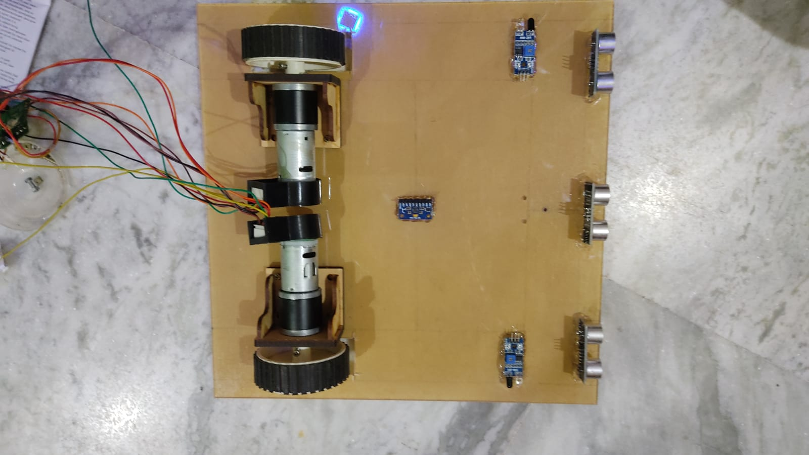

Slide 22
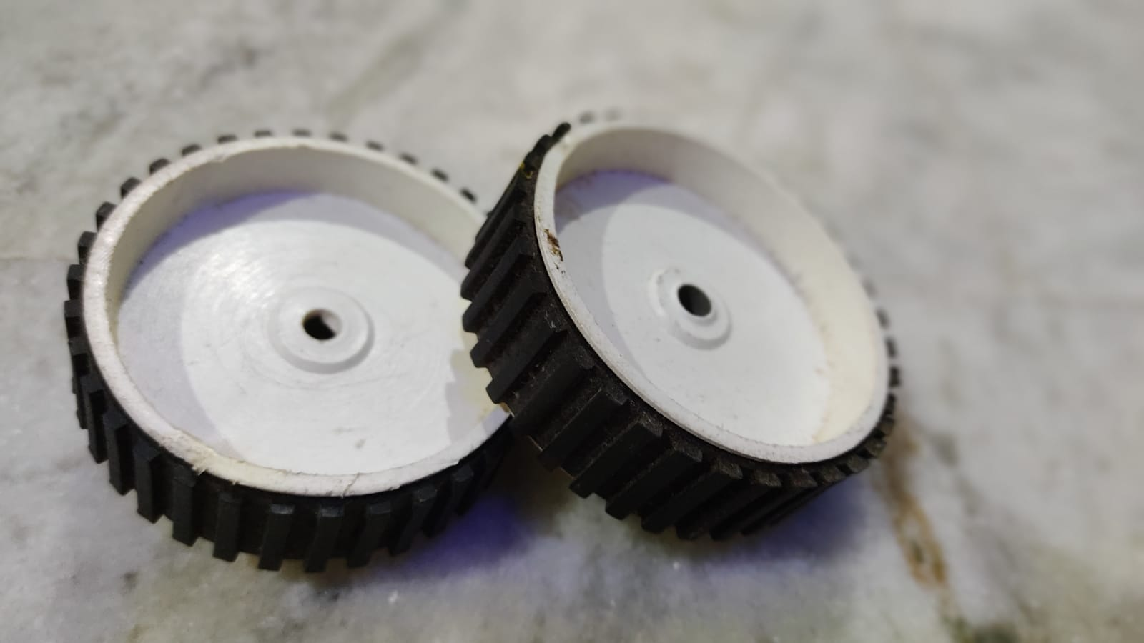

Slide 23
Encoder check
Need to observe the encoder data when motor spins..
In psrt.ino the program is not reliable as the data keeps toggling from 0-32600- -32600-0 .
so the problem is with volatile int as the encoder value is very large , so debugged by using volatile long.
Along with it the atomic block library is also not giving result as expected , so removed it.
Hence the final code is written in WATE.ino .

Slide 24
psrt.ino
void loop() {
// Read the position in an atomic block to avoid a potential
// misread if the interrupt coincides with this code running
// see: https://www.arduino.cc/reference/en/language/variables/variable-scope-qualifiers/volatile/
int pos = 0;
ATOMIC_BLOCK(ATOMIC_RESTORESTATE) {
pos = posi;
}
Serial.println(pos);
}
void readEncoder(){
int b = digitalRead(ENCB);
if(b > 0){
posi=posi+100;
}
else{
posi= posi-100;
}
}
#include <util/atomic.h> // For the ATOMIC_BLOCK macro
#define ENCA 3// YELLOW
#define ENCB 8 // WHITE
Volatile signed long posi = 0; // specify posi as volatile signed
void setup() {
Serial.begin(9600);
pinMode(ENCA,INPUT_PULLUP);
pinMode(ENCB,INPUT);
attachInterrupt(digitalPinToInterrupt(ENCA),readEncoder,RISING);
}
}

Slide 25
WATE.ino
const int A=3;
const int B=8;
volatile long tick =0; //this where the error is present //unsigned
void setup(){
Serial.begin(115200);
pinMode(A,INPUT_PULLUP);
pinMode(B,INPUT);
attachInterrupt(digitalPinToInterrupt(A),Funct,RISING);
}
void loop(){
Serial.println(tick);
}
void Funct(){
int b = digitalRead(B);
if(b== 1){
tick =tick+100;
}
else if(b==0){
tick=tick-100;
}
}

Slide 26
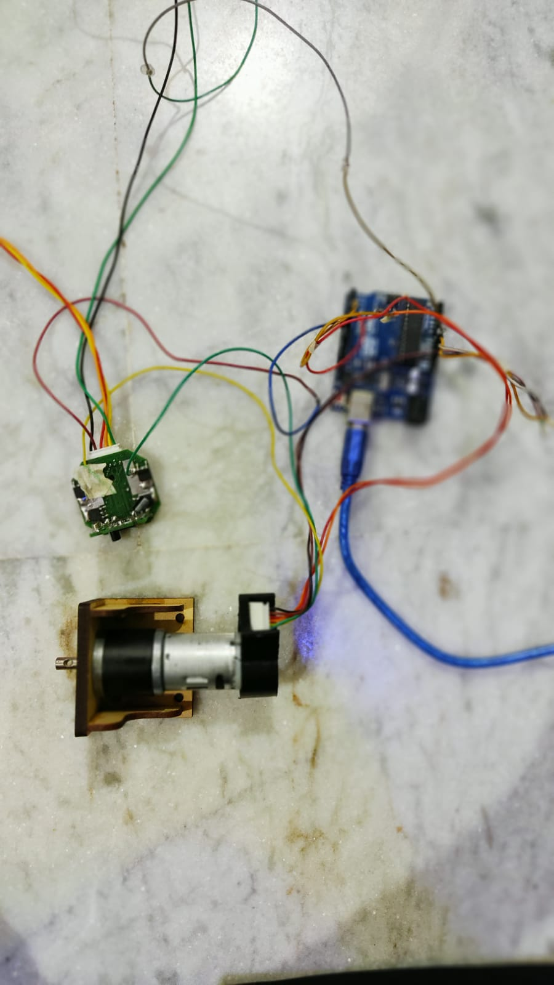
Motor test with Arduino

Slide 27
Motor control with driver
void setup(){
//initiallize default ppm values
for(int i=0; i<CHANNEL_NUMBER; i++){
ppm[i]= CHANNEL_DEFAULT_VALUE;
}
pinMode(sigPin, OUTPUT);
digitalWrite(sigPin, !onState); //set the PPM signal pin to the default state (off)
cli();
TCCR1A = 0; // set entire TCCR1 register to 0
TCCR1B = 0;
OCR1A = 100; // compare match register, change this
TCCR1B |= (1 << WGM12); // turn on CTC mode
TCCR1B |= (1 << CS11); // 8 prescaler: 0,5 microseconds at 16mhz
TIMSK1 |= (1 << OCIE1A); // enable timer compare interrupt
sei();
//--------------------------+++++++++++++++++++++++++++++++++++++++++-----------------------------
Serial.begin(115200);
pinMode(A,INPUT_PULLUP);
pinMode(B,INPUT_PULLUP);
attachInterrupt(digitalPinToInterrupt(A),Funct,RISING);
}
//--------------------------+++++++++++++++++++++++++++++++++++++++++--
#define CHANNEL_NUMBER 1 //set the number of channel
#define CHANNEL_DEFAULT_VALUE 1500 //set the default value
#define FRAME_LENGTH 4800 //set the PPM frame length in microseconds (1ms = 1000µs)
#define PULSE_LENGTH 1660 //set the pulse length in microseconds (The PPM signal pulse width must range from 600us to 2.4ms. The motor speed will be zero at PPM pulse width of 1.51ms)
#define onState 1 //set polarity of the pulses: 1 is positive, 0 is negative
#define sigPin 9 //set PPM signal output pin on the arduino
int ppm[CHANNEL_NUMBER];
//--------------------------+++++++++++++++++++++++++++++++++++++++++--
const int A=3;
const int B=8;
volatile long tick =0;// specify posi as volatile: https://www.arduino.cc/reference/en/language/variables/variable-scope-qualifiers/volatile/

Slide 28
if(cur_chan_numb >= CHANNEL_NUMBER){
cur_chan_numb = 0;
calc_rest = calc_rest + PULSE_LENGTH;
OCR1A = (FRAME_LENGTH - calc_rest) * 2;
calc_rest = 0;
}
else{
OCR1A = (ppm[cur_chan_numb] - PULSE_LENGTH) * 2;
calc_rest = calc_rest + ppm[cur_chan_numb];
cur_chan_numb++;
}
}
}
void Funct(){
int b = digitalRead(B);
if(b== 1){
tick =tick+1;
}
else if(b==0){
tick=tick-1;
}
}
void loop(){
.println(tick);
}
ISR(TIMER1_COMPA_vect){ //leave this alone
static boolean state = true;
TCNT1 = 0;
if (state) { //start pulse
digitalWrite(sigPin, onState);
OCR1A = PULSE_LENGTH * 2;
state = false;
} else{ //end pulse and calculate when to start the next pulse
static byte cur_chan_numb;
static unsigned int calc_rest;
digitalWrite(sigPin, !onState);
state = true;

Slide 29
Control motor direction and position with driver and encoder..
#define CHANNEL_NUMBER 1 //set the number of channel
#define CHANNEL_DEFAULT_VALUE 1500 //set the default value
#define FRAME_LENGTH 4800 //set the PPM frame length in microseconds (1ms = 1000µs)
#define onState 1 //set polarity of the pulses: 1 is positive, 0 is negative
#define sigPin 9 //set PPM signal output pin on the arduino
int PULSE_LENGTH; //set the pulse length in microseconds (The PPM signal pulse width must range from 600us to 2.4ms. The motor speed will be zero at PPM pulse width of 1.51ms)
int ppm[CHANNEL_NUMBER];
////////////////////////
const int A=3; //encoderA to pin3 and encoderB to pin8
const int B=8;
volatile long tick =0; //this where the bug is present //unsigned
int Encoder_cpr ;
int distance = ?;

Slide 30
Setup
OCR1A = 100; // compare match register, change this
TCCR1B |= (1 << WGM12); // turn on CTC mode
TCCR1B |= (1 << CS11); // 8 prescaler: 0,5 microseconds at 16mhz
TIMSK1 |= (1 << OCIE1A); // enable timer compare interrupt
sei();
Encoder_cpr=((distance/44)*7*133600*radius); //wheel radius
}
void loop(){
Serial.println(tick);
}
void setup(){
Serial.begin(115200);
//initiallize default ppm values
for(int i=0; i<CHANNEL_NUMBER; i++){
ppm[i]= CHANNEL_DEFAULT_VALUE;
}
pinMode(sigPin, OUTPUT);
digitalWrite(sigPin, !onState); //set the PPM signal pin to the default state (off)
pinMode(A,INPUT_PULLUP);
pinMode(B,INPUT_PULLUP);
attachInterrupt(digitalPinToInterrupt(A),Funct,RISING);
cli();
TCCR1A = 0; // set entire TCCR1 register to 0
TCCR1B = 0;

Slide 31
Motor control
static unsigned int calc_rest;
digitalWrite(sigPin, !onState);
state = true;
if(cur_chan_numb >= CHANNEL_NUMBER){
cur_chan_numb = 0;
calc_rest = calc_rest + PULSE_LENGTH;
OCR1A = (FRAME_LENGTH - calc_rest) * 2;
calc_rest = 0;
}
else{
OCR1A = (ppm[cur_chan_numb] - PULSE_LENGTH) * 2;
calc_rest = calc_rest + ppm[cur_chan_numb];
cur_chan_numb++;
}
}
}
ISR(TIMER1_COMPA_vect){ //leave this alone
if( tick >= Encoder_cpr){
PULSE_LENGTH = 1510 ;
}
static boolean state = true;
TCNT1 = 0;
if (state) { //start pulse
digitalWrite(sigPin, onState);
OCR1A = PULSE_LENGTH * 2;
state = false;
} else{ //end pulse and calculate when to start the next pulse
static byte cur_chan_numb;

Slide 32
Position check from encoder (feedback)
void Funct(){
int b = digitalRead(B);
if(b== 1){
tick =tick+100;
}
else if(b==0){
tick=tick-100;
}
}

Slide 33
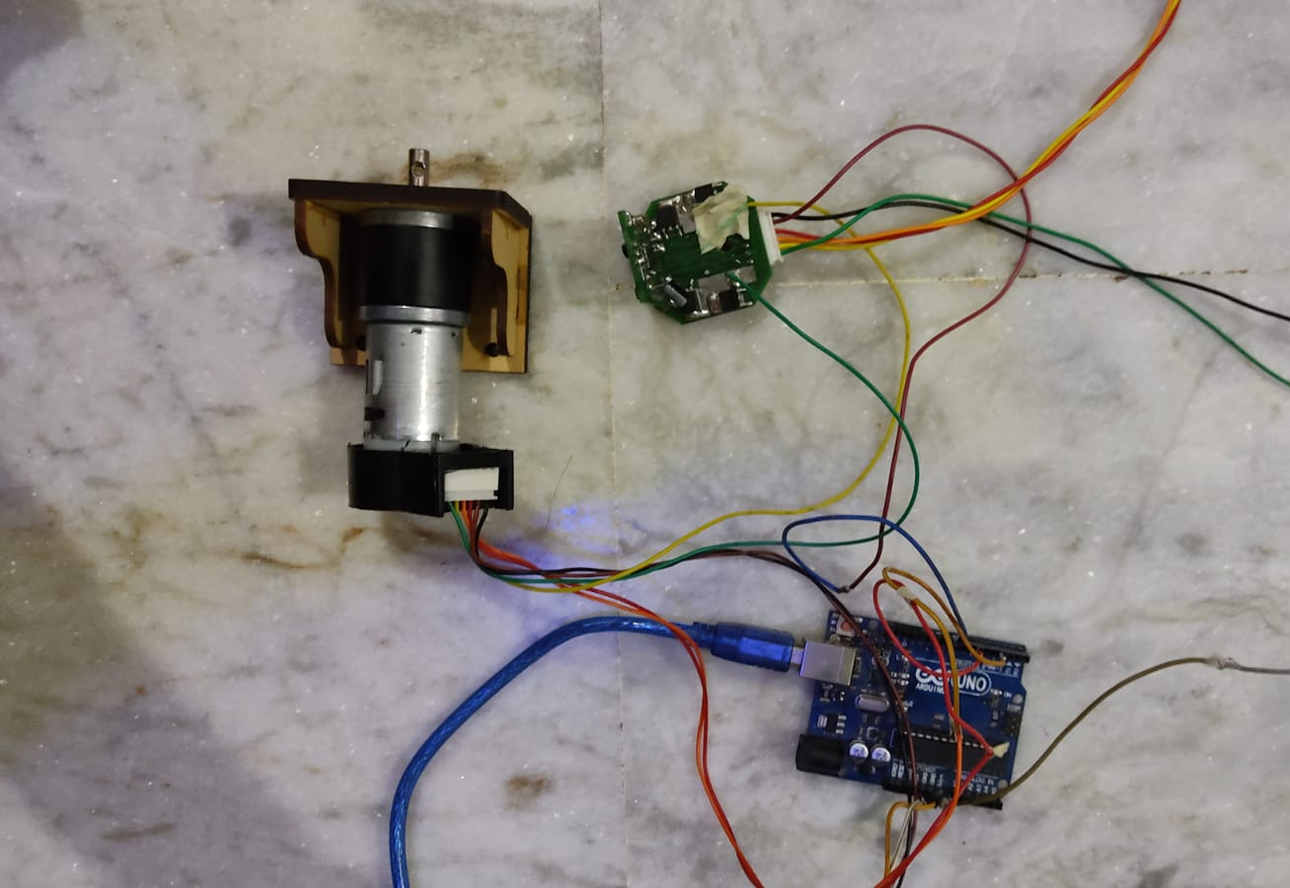
Tested Speed ✓ Position ✓

Slide 34
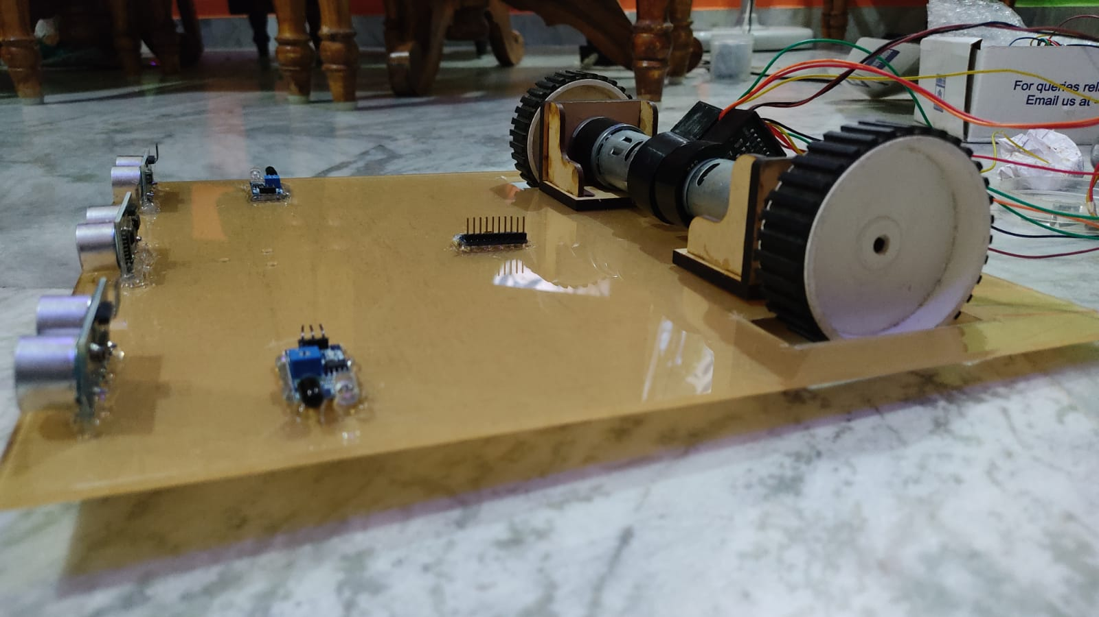
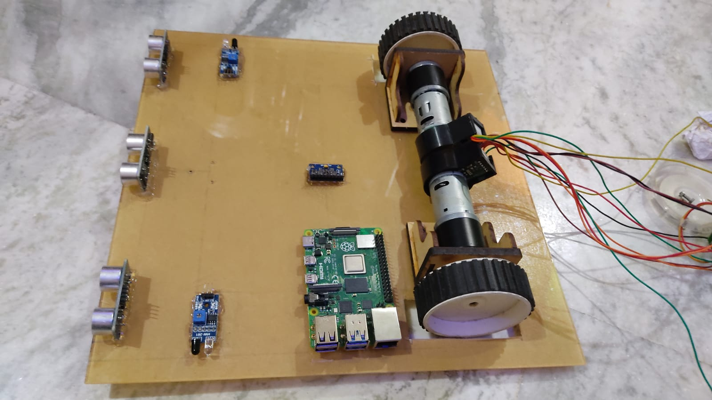
Test product -1.0

Slide 35
